Slide 1

Year 6
Meet the Teacher

Slide 2
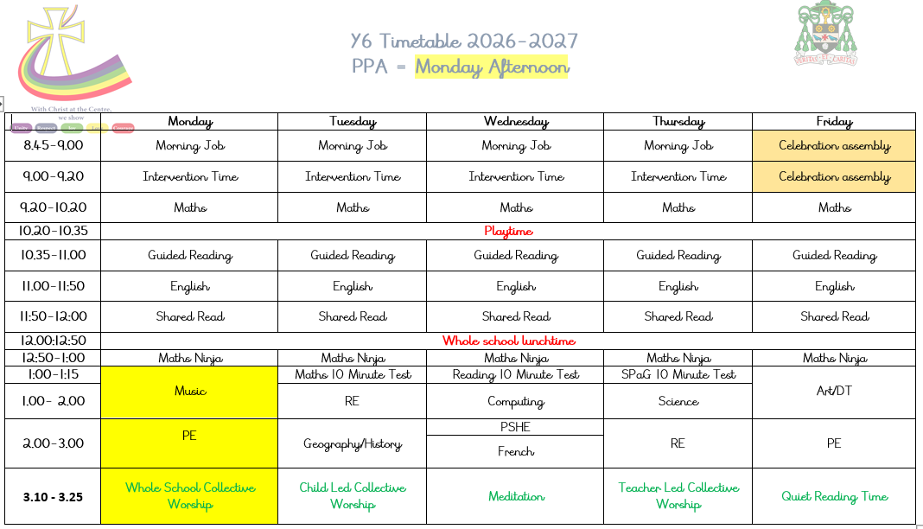

Slide 3

Reading
Guided Reading – whole class guided reading with focus on oracy
Changing books – in Year 6, it is up to the children to change their books when needed. Many will go onto Free Reading soon.
Children MUST read at least 3x a week at home (ask comprehension too).
Book Bands – as children get older, moving up book bands will become less common.

Slide 4
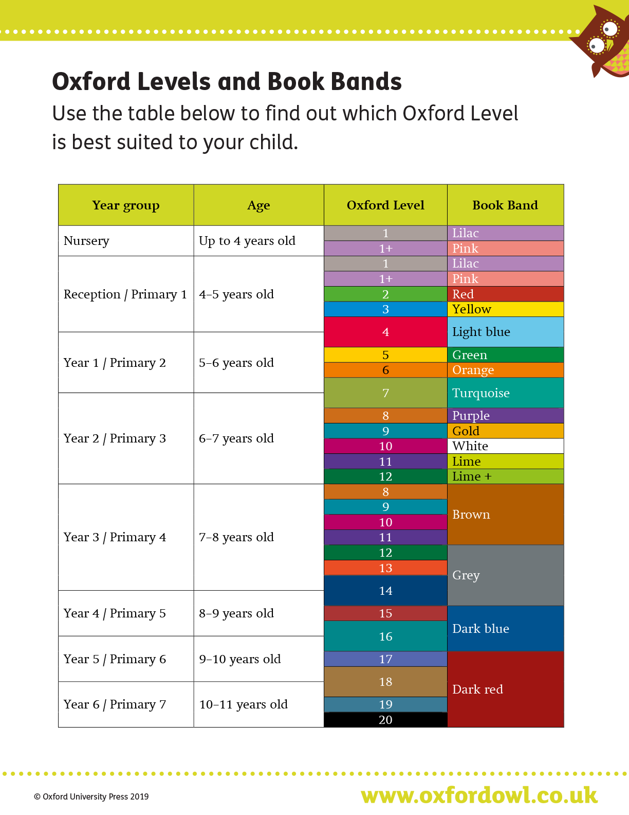

Slide 5

Maths
White Rose Maths approach – this will be done topic by topic.
Daily flashback four and challenge for all pupils.
Homework books – slightly different this year. Arithmetic based in Year 6 (if we can succeed with this, then your child has a really good chance of passing)
Times Table Rockstars – login in children's reading records – complete this as much as possible. As much practise as possible please.

Slide 6
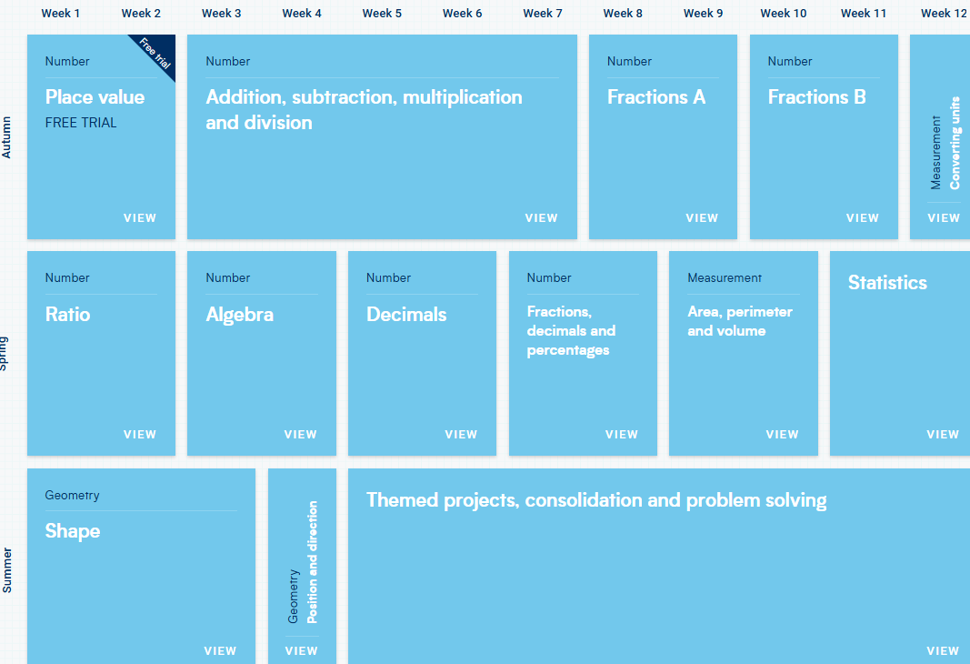

Slide 7

English
All new learning objectives can be found on the National Curriculum website.
Scheme – Literacy Tree
We will teach these objectives throughout the year.
SPaG Starters/Weekly tests
Clamping down on basic punctuation again.

Slide 8
Spelling
Weekly spelling sessions using Spelling Seeds– in depth look into that week’s spelling words.
Mini spelling tests every day.
Practise continuously throughout the half term.

Slide 9
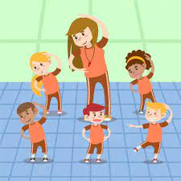
PE
This year, children will have 2 hours of PE a week.
On LTP on website, it will tell you what your child will be learning each half term.
PE days are Monday and Friday – however, PE kit needs to be in EVERY DAY.
Kit = white t-shirt, navy joggers/shorts, navy hoodie if cold.
Lots of opportunities for competitions/clubs.

Slide 10

Foundation Subjects
We are now using KAPOW for the majority of our Foundation Subjects
Subject experts have created resources to assist with planning for these lessons
Pupil feedback has been positive

Slide 11
Homework
Reading x3 a week
Maths homework once a week
Reading homework once a week
Spellings and times tables continuously
Topic homework once a term

Slide 12
SATs Prep
Termly practice tests
Weekly SPaG, reading and maths SAT’s style question mini quizzes.
Test practice will increase as the year goes on.

Slide 13
Behaviour
Positivity is key =
Dojo points
Table points
Over and above board
Extra Friday breaktime (marbles)
Celebration assembly certificates
Class Trophy
Mary’s Market
Consequences =
Verbal Warning
Verbal Reminder
Reflection Time
Parents
SLT

