Slide 1



Welcome to y1!
Mrs Wilton-Moule
Miss Neale and Mrs Manning
Mrs Glancy

Slide 2
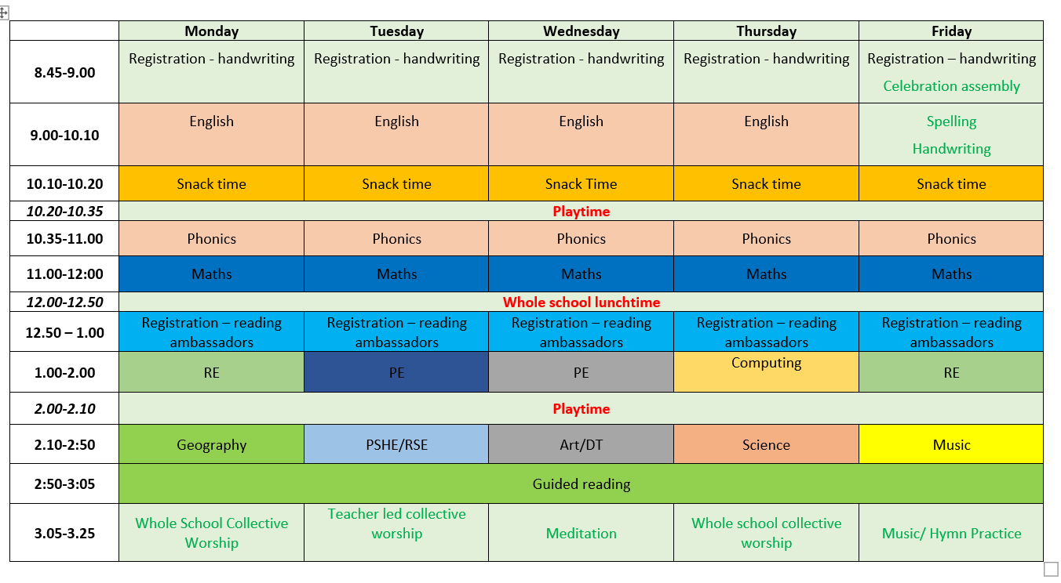
Timetable and routines

Slide 3
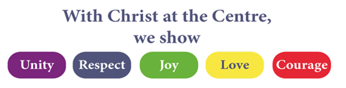
SCHOOL VALUES
Our 4 rules
Be safe
Be ready
Be respectful
Be kind
"Be kind and compassionate to one another, forgiving each other, just as in Christ God forgave you." Ephesians 4:32

Slide 4
REWARDS LADDER
Level 5 Head teacher’s award Parent’s informed, certificate given out in Celebration Assembly. Mary’s Market
Level 4 Weekly celebration certificates and ask me about stickers
Level 3 Class reward
Level 2 Verbal praise, Class Dojo points (totalled each week; house cup and class of the week trophies awarded)
Level 1 Verbal praise, Dojo points.

Slide 5
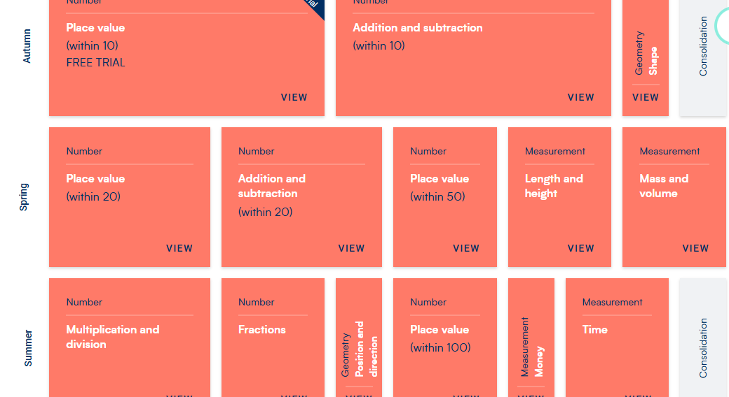
MATHS

Slide 6
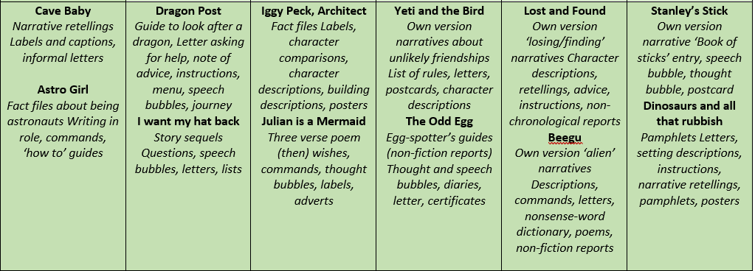
WRITING
Spellings and patterns taught this half term
the, a, do, to, today
compound words (football, toothbrush etc)
Adding -ing to words (hooting, growling, roaring, stomping etc)
Adding -ed to words (cooked, played, roared etc)

Slide 7
Reading
The reading book that will be sent home is to consolidate the phonics sounds taught in class.
This will be replaced when the next set of sounds has been taught (likely every Friday) but will become more frequent throughout the year.

Slide 8
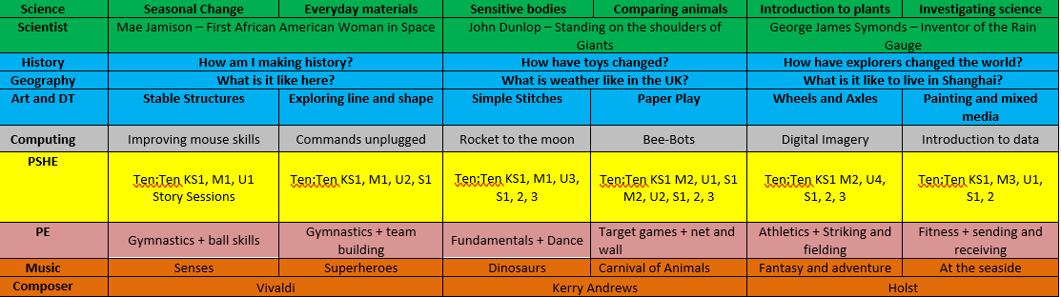
TOPICs

Slide 9
ASSESSMENTS
Teacher assessments – 3 assessment points a year at the end of each term.
WTS, EXS or GDS for each subject – this will be discussed at the parents’ evening.
Formal assessments – Phonics Screening Check in June 2027

Slide 10
DAYS TO NOTE
PE DAYS – Tuesday and Wednesday
Maths homework books (after half-term) – Wednesday
Reading Raffle – Friday – 3 x week at home=raffle ticket

